Slide 1
MTA Subway Terminal On-Time Performance ANALYSIS
BIA 610 : Applied Analytics Final Project by:
Sai Sruthi Chalasani
Sahithi Setty
Venkata Sandilya Bagavathula

Slide 2
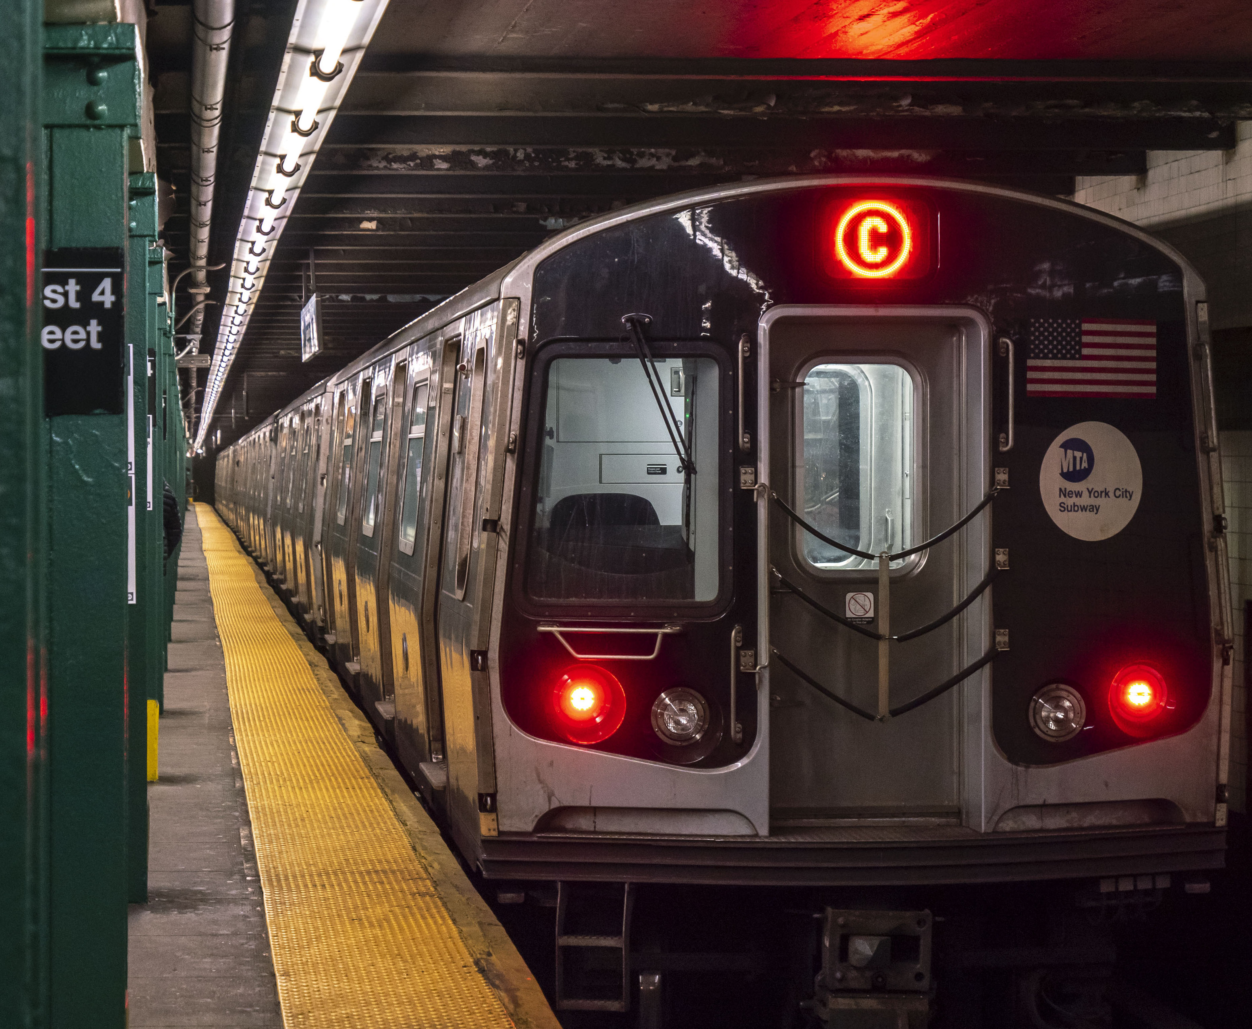
INTRODUCTION
MTA: New York City Subway Transit
The MTA subway is a crucial transportation system for the people of New York City, providing reliable and affordable access to work, education, and leisure activities. It is a vital component of the city's infrastructure and economy.
With millions of people depending on it every day, it's crucial that the subway runs smoothly and efficiently. In order to ensure that trains arrive on time and that the system is operating at peak performance, it's essential to understand how the system is performing.

Slide 3

INTRODUCTION
Analyzing New York City's Subway System Performance
In this analysis, we explore the on-time performance of the MTA subway system from 2015 to 2019. We aim to answer several business questions such as identifying the best and worst on-time terminal performances by year and line, understanding how terminal on-time performance varies by month and line, and identifying the top 7 lines with the best on-time performance. Additionally, we will also identify the top 7 busiest stations in the subway system.

Slide 4

INTRODUCTION
How will the analysis benefit the users
The analysis will provide insights to the users into the reliability and efficiency of the subway system. Understanding which lines and terminals have the best on-time performance can help commuters plan their routes and schedules more effectively. Additionally, identifying the busiest stations can help commuters avoid potential crowds and delays. Overall, by analyzing the subway system's on-time performance, we can gain a better understanding of its strengths and weaknesses and make more informed decisions as subway users

Slide 5
DATA PREPARATION
The dataset
The dataset was sourced from data.gov. It includes the information on the on-time performance of subway terminals in New York City between 2015-2019.
The dataset has 7 columns: month, line, division, day_type, num_on_time_trips, num_sched_trips, and terminal_on_time_performance.
The month column indicates the month and year and the "line" column indicates the subway line (e.g., 1, 2, 3, A, B, C, S 42nd, S Fkln, S Rock).
The "division" column indicates the subway division (A or B Division) while the day_type column indicates whether the data was collected on a weekday (1) or a weekend (2).
The "num_on_time_trips" column indicates the number of on-time trips recorded for the given terminal, line, division, and day type.
The "num_sched_trips" column indicates the number of scheduled trips recorded for the given terminal, line, division, and day type.
The "terminal_on_time_performance" column indicates the percentage of on-time trips for the given terminal, line, division, and day type.

Slide 6
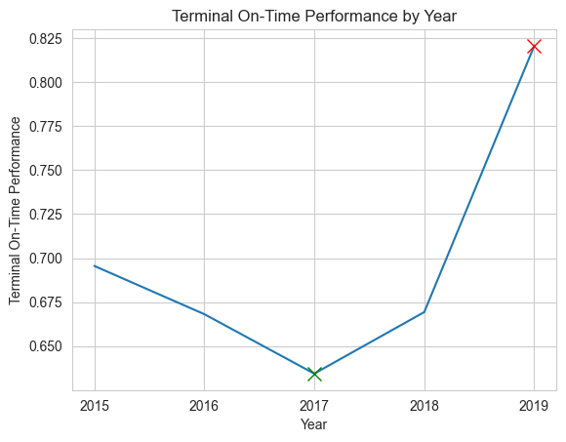
EXPLORATORY DATA ANALYSIS
1. The best and worst "on-time terminal performance" by year

Slide 7
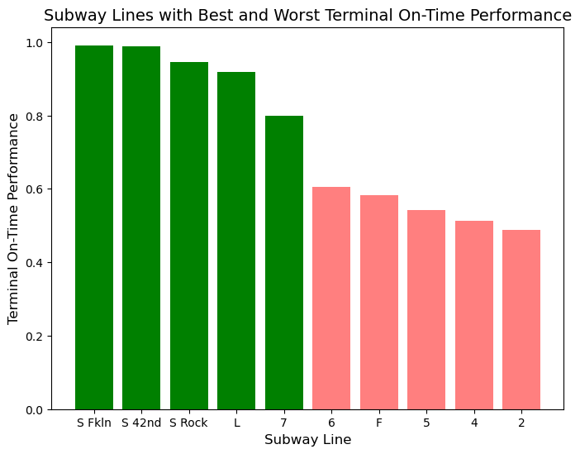
EXPLORATORY DATA ANALYSIS
2. Best and worst terminal on-time performance by line

Slide 8
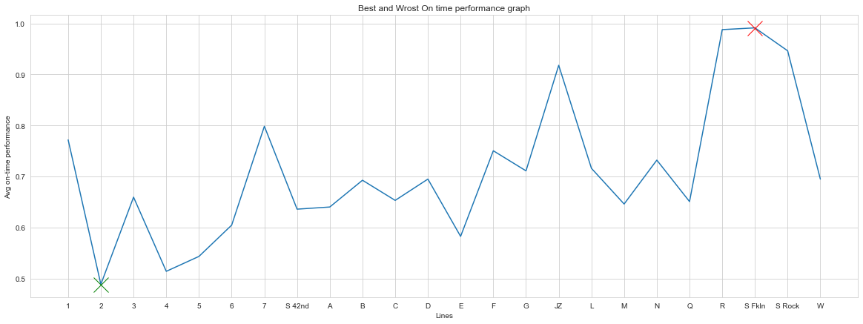
EXPLORATORY DATA ANALYSIS
3. Best and worst terminal on-time performance by line

Slide 9
EXPLORATORY DATA ANALYSIS
3. How does terminal on-time performance vary by month and line?

Slide 10
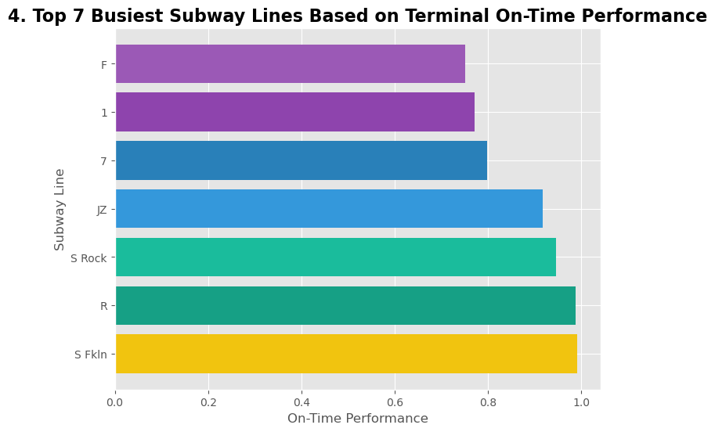
EXPLORATORY DATA ANALYSIS

Slide 11
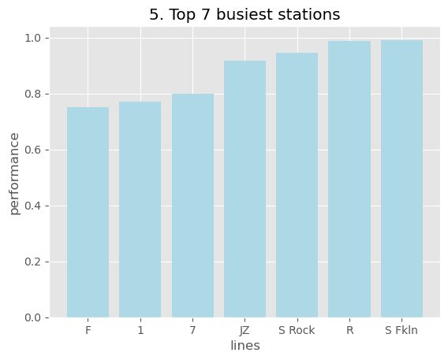
EXPLORATORY DATA ANALYSIS

Slide 12
Key Findings
Overall on-time performance trends from 2015-2019
Which lines had the best and worst performance?
How did performance vary by day of the week and time of day?

Slide 13
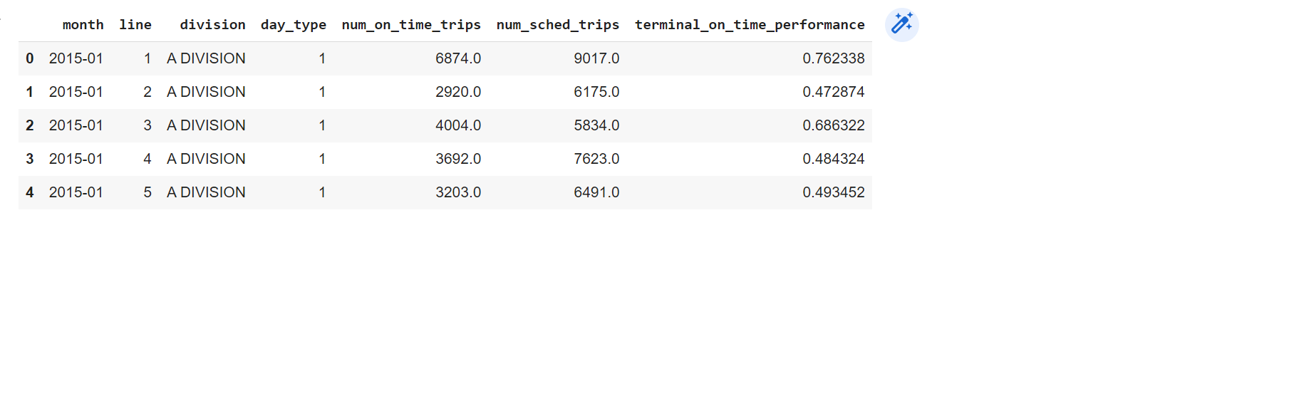
Importing and Previewing MTA Subway Terminal On-Time Performance Data with Pandas
The dataset contains information about subway lines, divisions, day types, and the number of scheduled and on-time trips, along with the terminal on-time performance for each month. The data is organized in columns, including month, line, division, day_type, num_on_time_trips, num_sched_trips, and terminal_on_time_performance. The head() function is used to display the first five rows of the dataset.

Slide 14
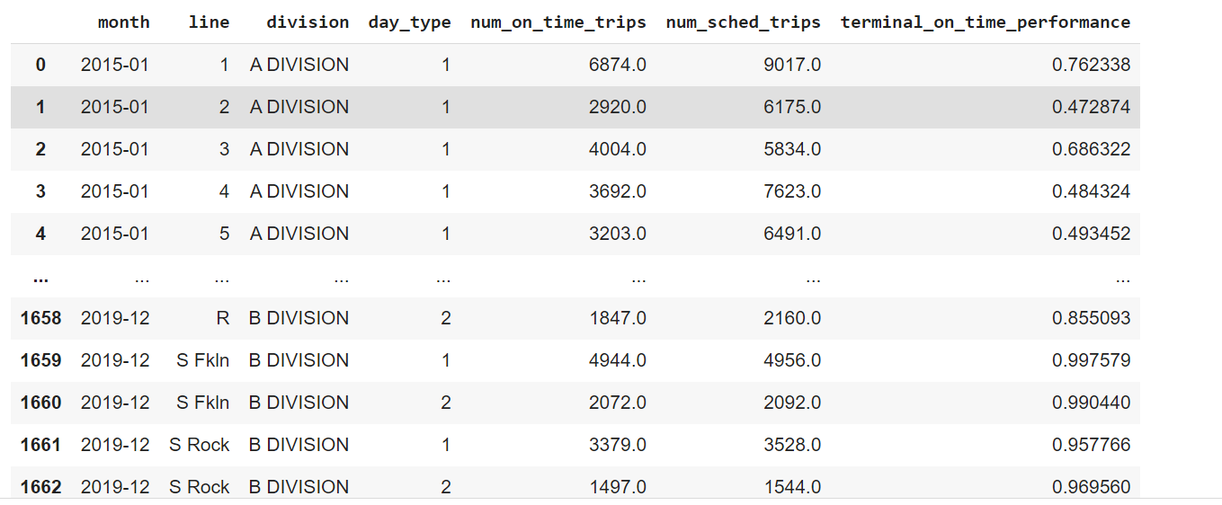
Removing Rows Containing "Systemwide" from the data
The data has been filtered to exclude the rows with the "Systemwide" line and includes information on the month, line, division, day type, number of on-time trips, number of scheduled trips, and the terminal on-time performance. There are 1,596 rows and 7 columns in this data set.

Slide 15
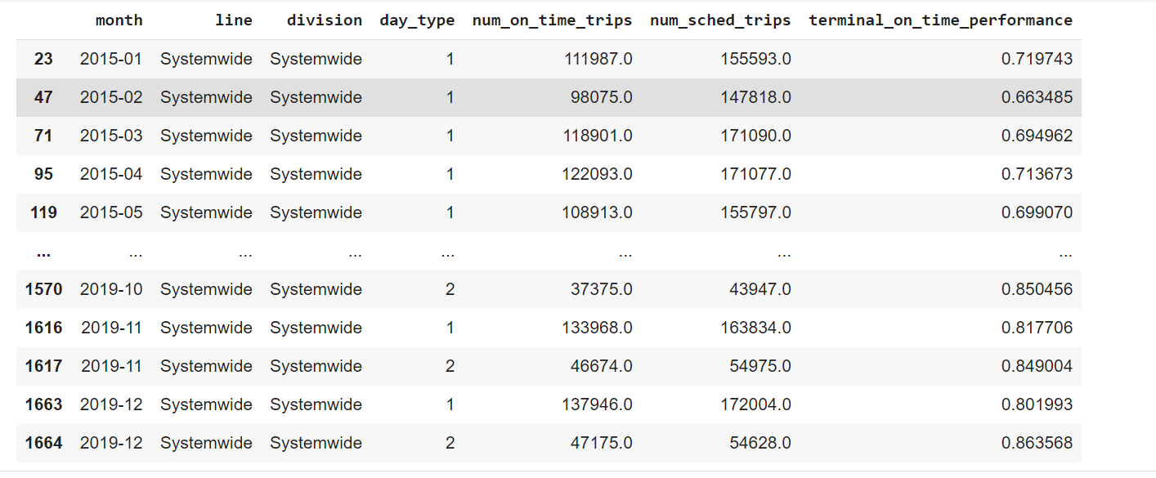
Creating a Data Frame for Systemwide Information
This data frame contains information on the on-time performance of the MTA Subway Terminal Systemwide for the years 2015-2019. It includes the month, day type, number of on-time trips, number of scheduled trips, and terminal on-time performance (as a percentage) for each month and day type. The data frame only includes information for the Systemwide line. The total number of rows are 69 and columns are 7.

Slide 16
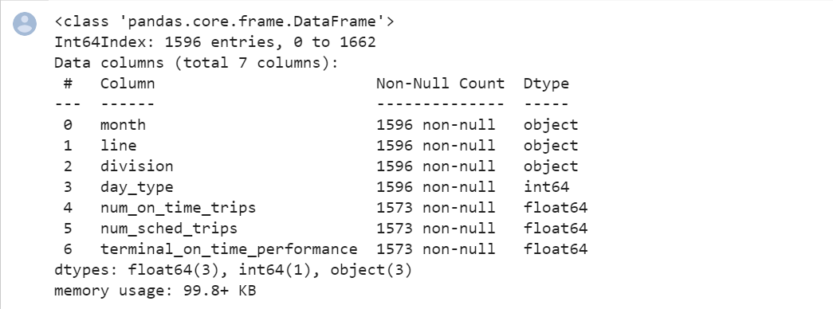
Inspecting Data Types of Features
The output shows the data type of the features present in the data set using the pandas library. It is represented as a data frame with 7 columns that provide information on the features such as column name, count of non-null values, and data type. The data set has 1596 rows and 7 columns, and the columns contain data of types float, integer, and object. The memory usage of this data set is around 99.8 KB.

Slide 17
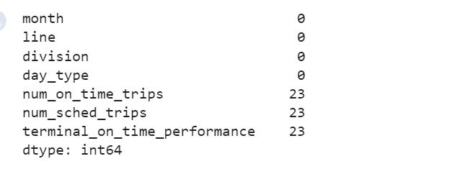
Checking Null Values in the Dataset
It shows the number of null values in each column of the data. As we can see, there are 23 null values in the columns 'num_on_time_trips', 'num_sched_trips', and 'terminal_on_time_performance'. It is important to identify and handle null values properly to avoid any errors or biases in the analysis.

Slide 18
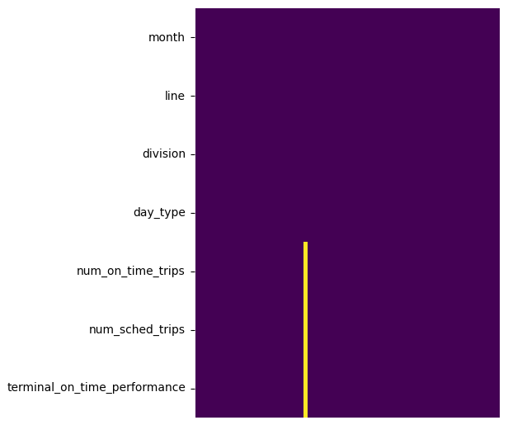
Heatmap of Missing Values in Data

Slide 19
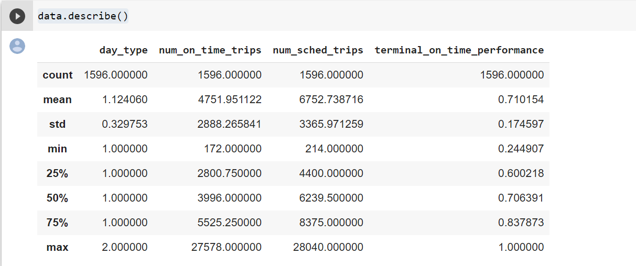
Descriptive statistics of the dataset
This slide presents a summary statistics of the dataset. The 'describe()' function is used to show the count, mean, standard deviation, minimum, maximum, and the quartiles of the 'day_type', 'num_on_time_trips', 'num_sched_trips', and 'terminal_on_time_performance' columns. The 'count' shows the number of non-null values in each column, and the 'mean' shows the average value. The 'std' represents the standard deviation, which measures the amount of variability or dispersion around the mean. The 'min' and 'max' show the minimum and maximum values in each column, respectively. The '25%', '50%', and '75%' are the values at the first quartile, median, and third quartile, respectively, and give an idea about the distribution of the data.

Slide 20
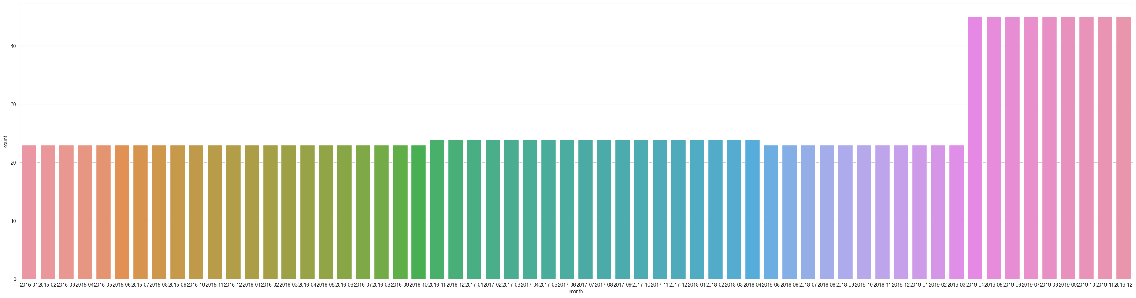
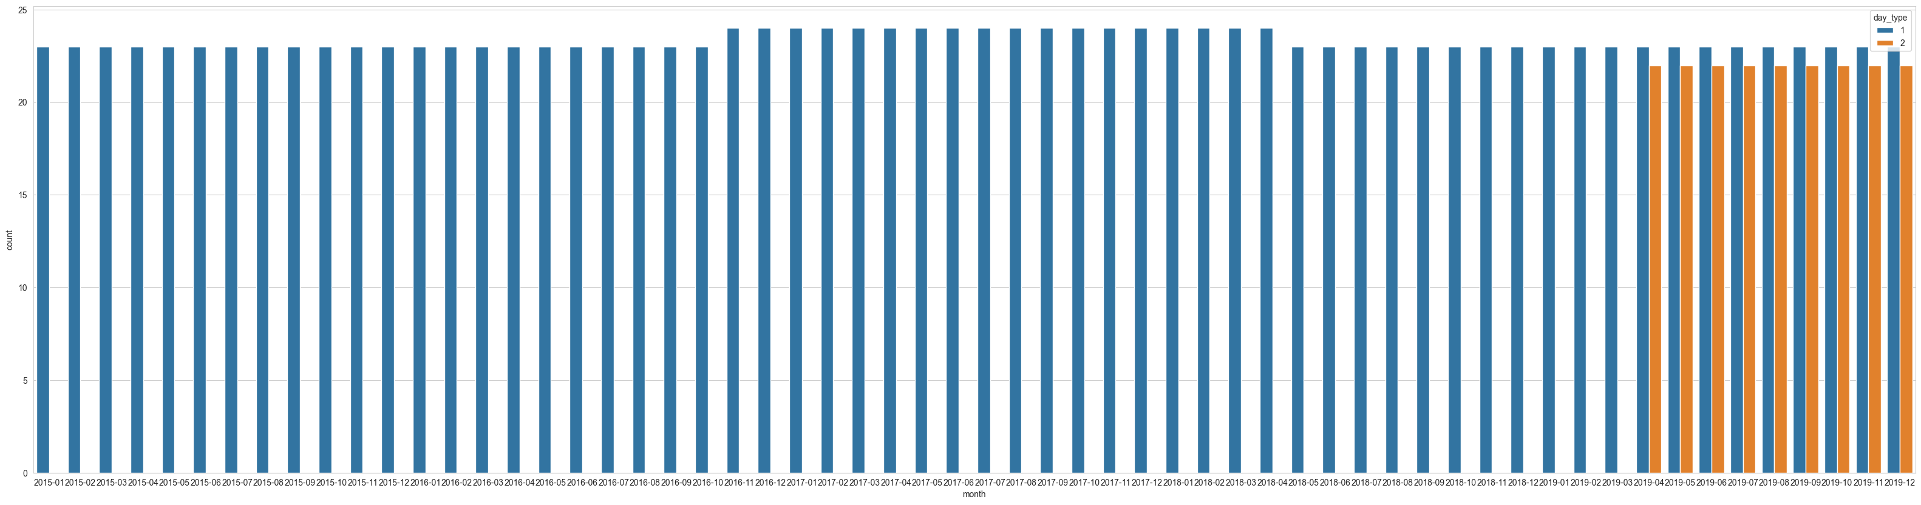
Visualizations of Month-wise Value Counts and Day Type Counts

Slide 21
From the Graph, it is clearly seen that in 2019, there were more entries i.e. (highest) more trains were scheduled compared to other years where as in 2015,2016 and 2018 has same number of train schedules and 2017 the number was bit higher than these years.

Slide 22
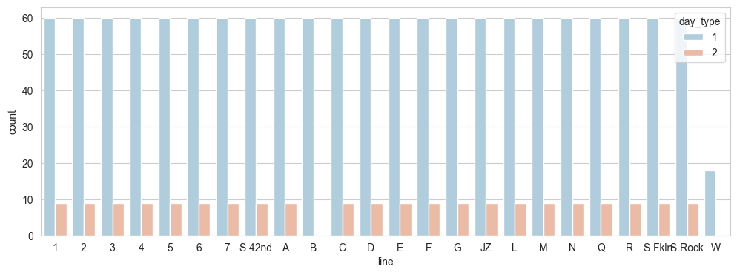
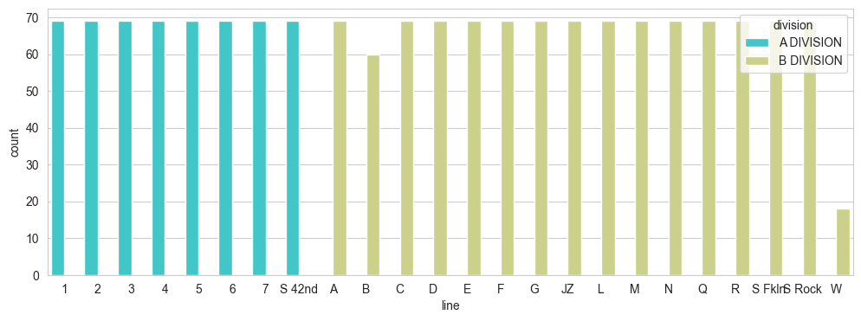
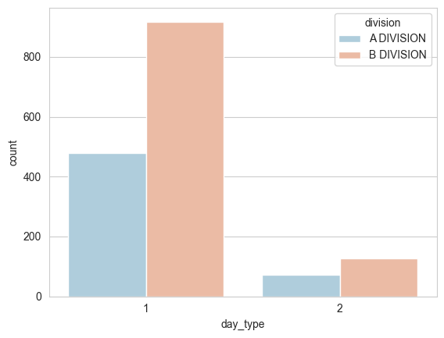
Visualizing Categorical Variables with Seaborn
The data analysis reveals that there were less scheduled trains on line 'W', and tracks 'W' and 'B' did not have Day_type 2 tracks. Additionally, the first 8 tracks are under A-division, and the later tracks are under B-division. These insights can help in identifying areas of improvement and optimizing train schedules for better performance.

Slide 23
Terminal On-Time Performance by Year - Line Graph
The data is grouped by year using the 'month' column, and the mean value of 'terminal_on_time_performance' is calculated. The resulting line graph shows the trend of performance over time. The red and green markers on the graph represent the years with the highest and lowest performances, respectively. The x-axis displays the years, and the y-axis shows the corresponding performance values.

Slide 24
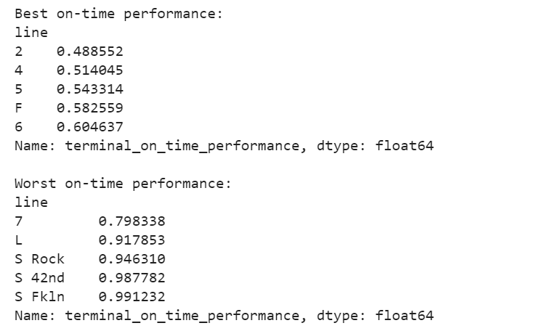
Subway Line Performance Comparison

Slide 25
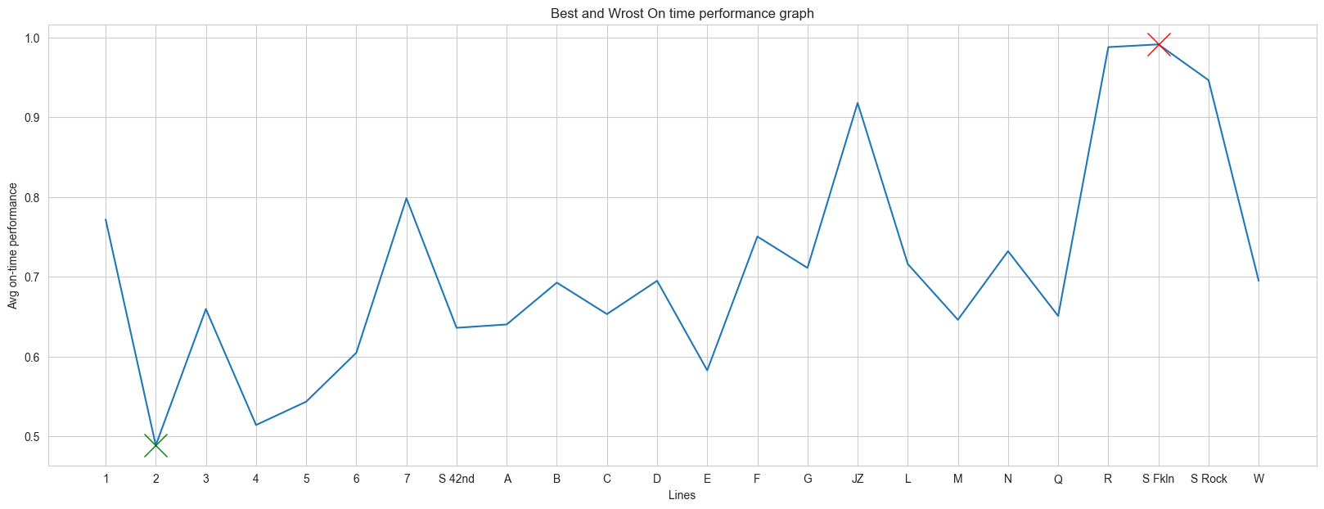
Average On-Time Performance for Subway Lines: Comparison of Best and Worst Performing Lines
This code groups the subway data by line and calculates the mean terminal on-time performance for each line. It then sorts the lines based on their performance and displays the top 5 and bottom 5 performing lines. Line 2 has the worst performance, while S Fkln has the best.

Slide 26
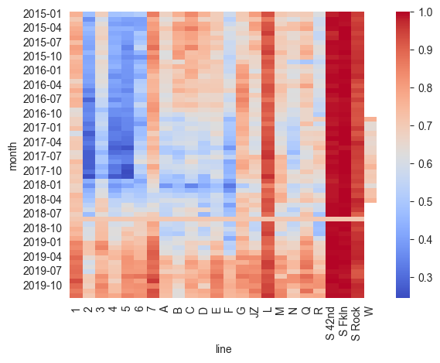
Terminal On-Time Performance by Month and Subway Line: Heatmap
This is a heatmap to visualize the mean terminal on-time performance for each month and subway line. The heatmap uses color to represent the performance value for each cell.

Slide 27
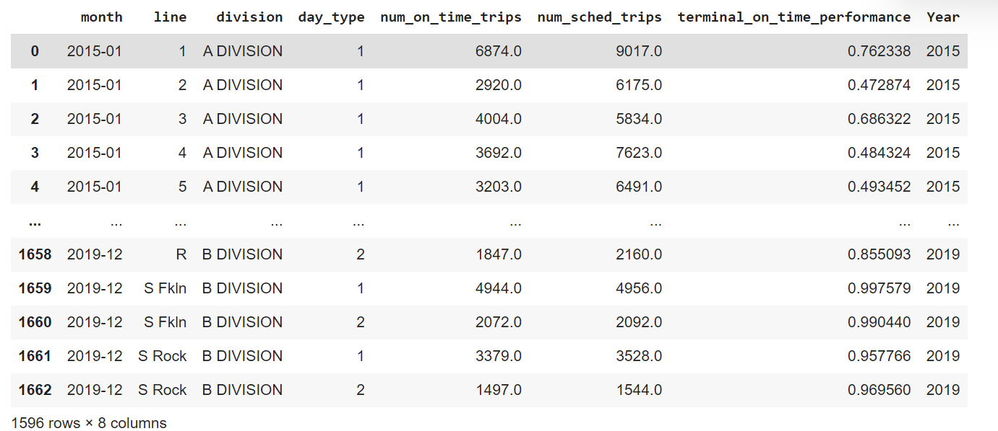
Extracting the Year from Month Column
This data includes information about the monthly performance of subway lines in terms of on-time arrivals. The data is divided by line, division, day type, number of on-time trips, number of scheduled trips, and terminal on-time performance. The year column is extracted from the month column using string manipulation. The data includes records from January 2015 to December 2019 and consists of 1596 rows and 8 columns.

Slide 28
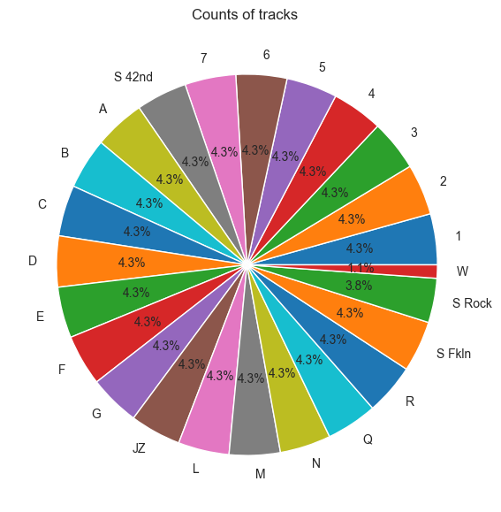
Analysis of Subway Lines based on Track Counts
This code checks the counts of unique values in the "line" column of the dataset and visualizes it using a pie chart. The pie chart shows the percentage distribution of the subway lines in the dataset.

Slide 29
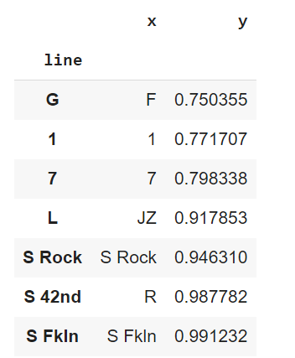
Top 7 lines that have best on-time performance
This shows the top 7 busiest stations based on the mean terminal on-time performance of each line. A barplot is used to display the data, with the x-axis representing the station lines and the y-axis representing the mean terminal on-time performance. The data is sorted by the mean performance in ascending order, and the top 7 stations are displayed in the data frame.

Slide 30
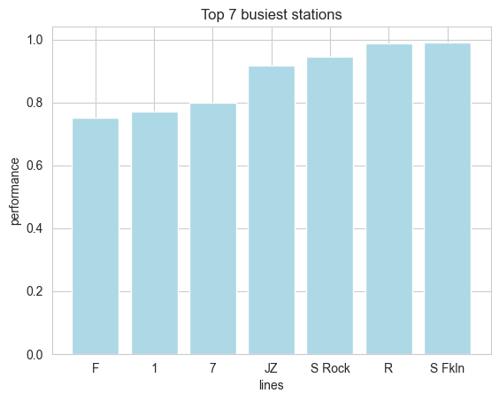
This data represents a bar plot for the top 7 busiest stations based on traffic, where the x-axis shows the lines and the y-axis shows the mean terminal on-time performance for each line. The data has been sorted based on the mean performance, and only the top 7 lines have been included in the plot. The plot helps visualize the performance of the busiest lines,and identify the lines that require attention to improve their performance.

Slide 31
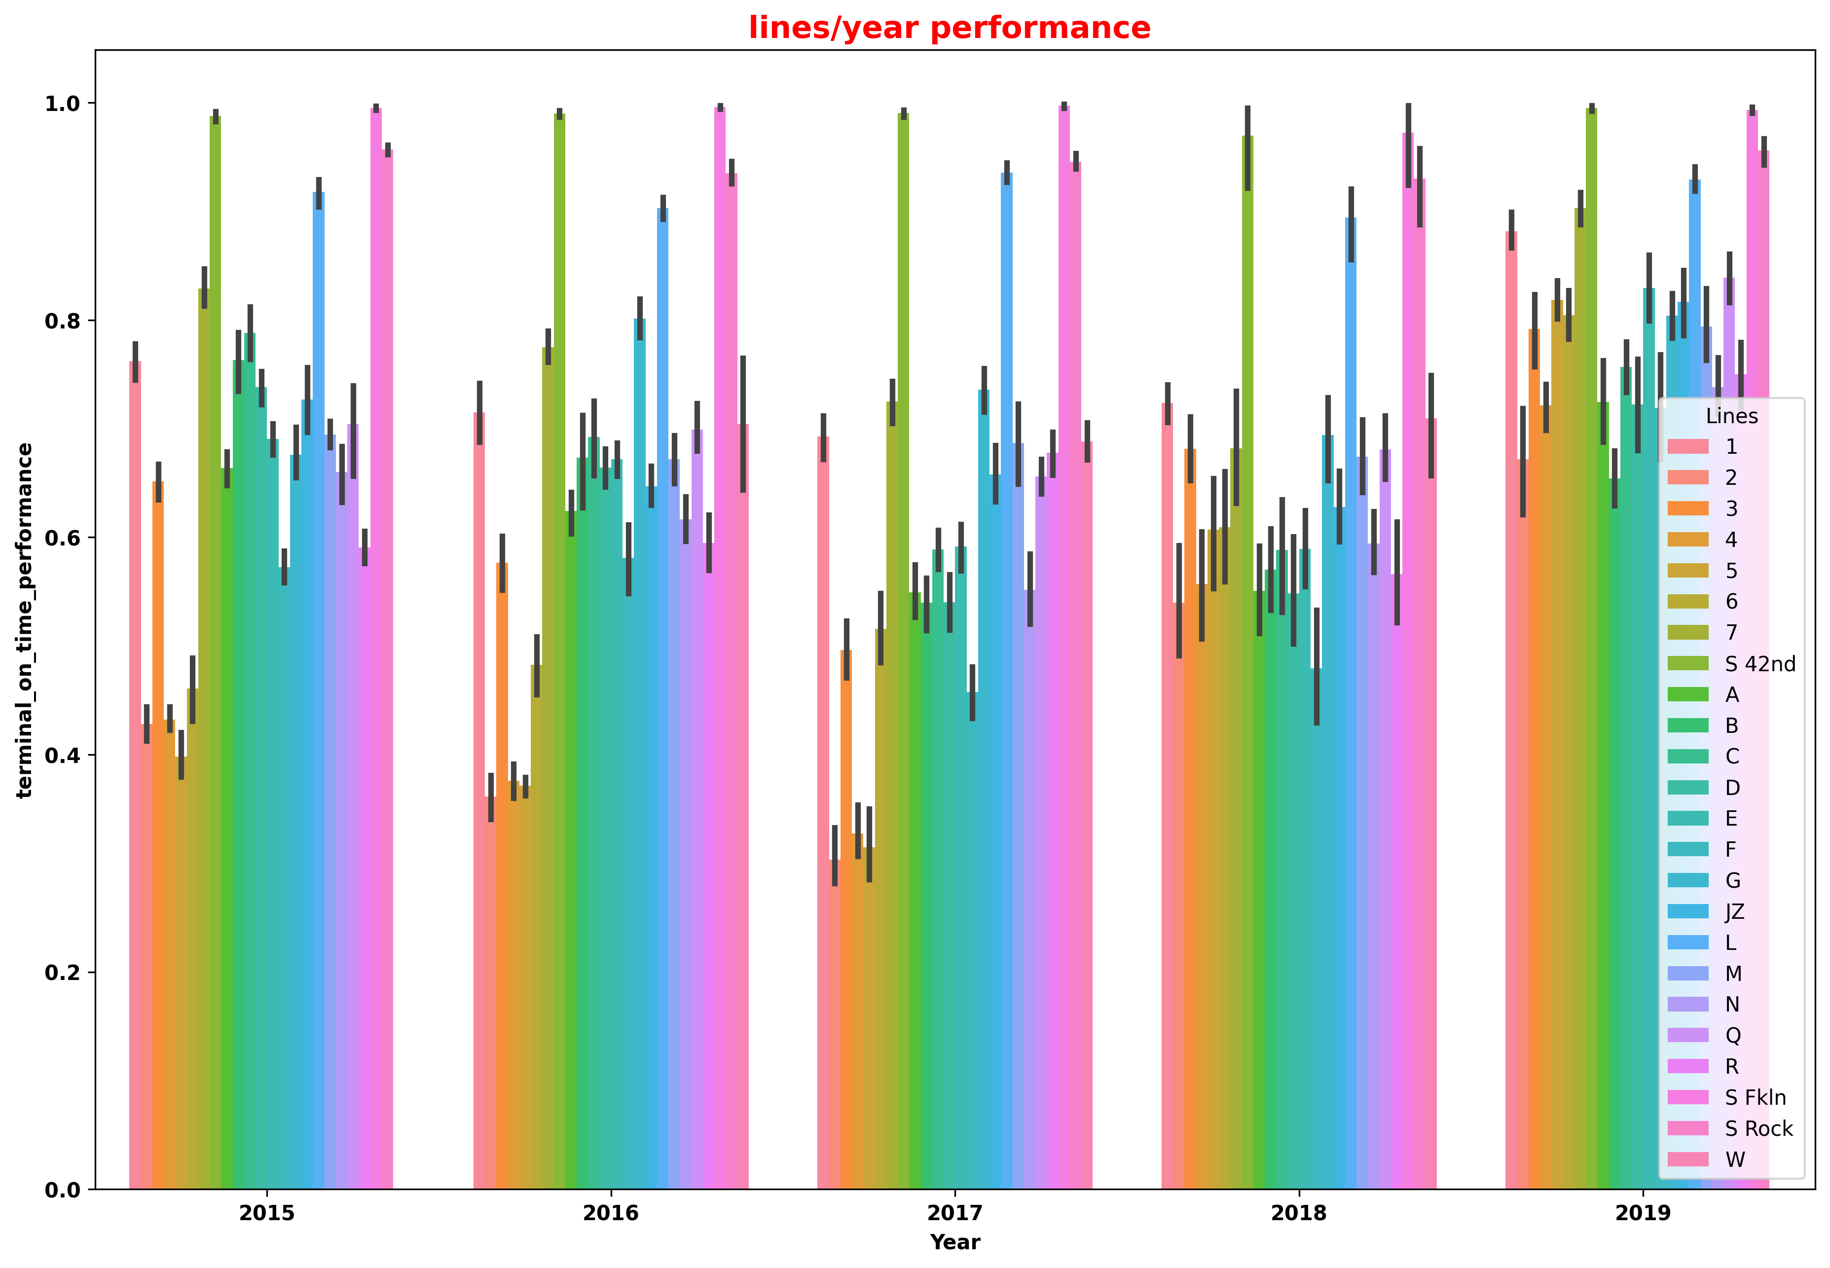
Bar plot for lines/year performance
This shows a barplot of lines/year performance based on the terminal on-time performance of different subway lines over the years. The graph is created using seaborn library in Python. The x-axis represents the year, the y-axis represents the terminal on-time performance, and each line is represented by a different color. The legend provides information about which line each color represents. This graph can be used to analyze the performance of different lines over the years and identify any trends or patterns.

Slide 32
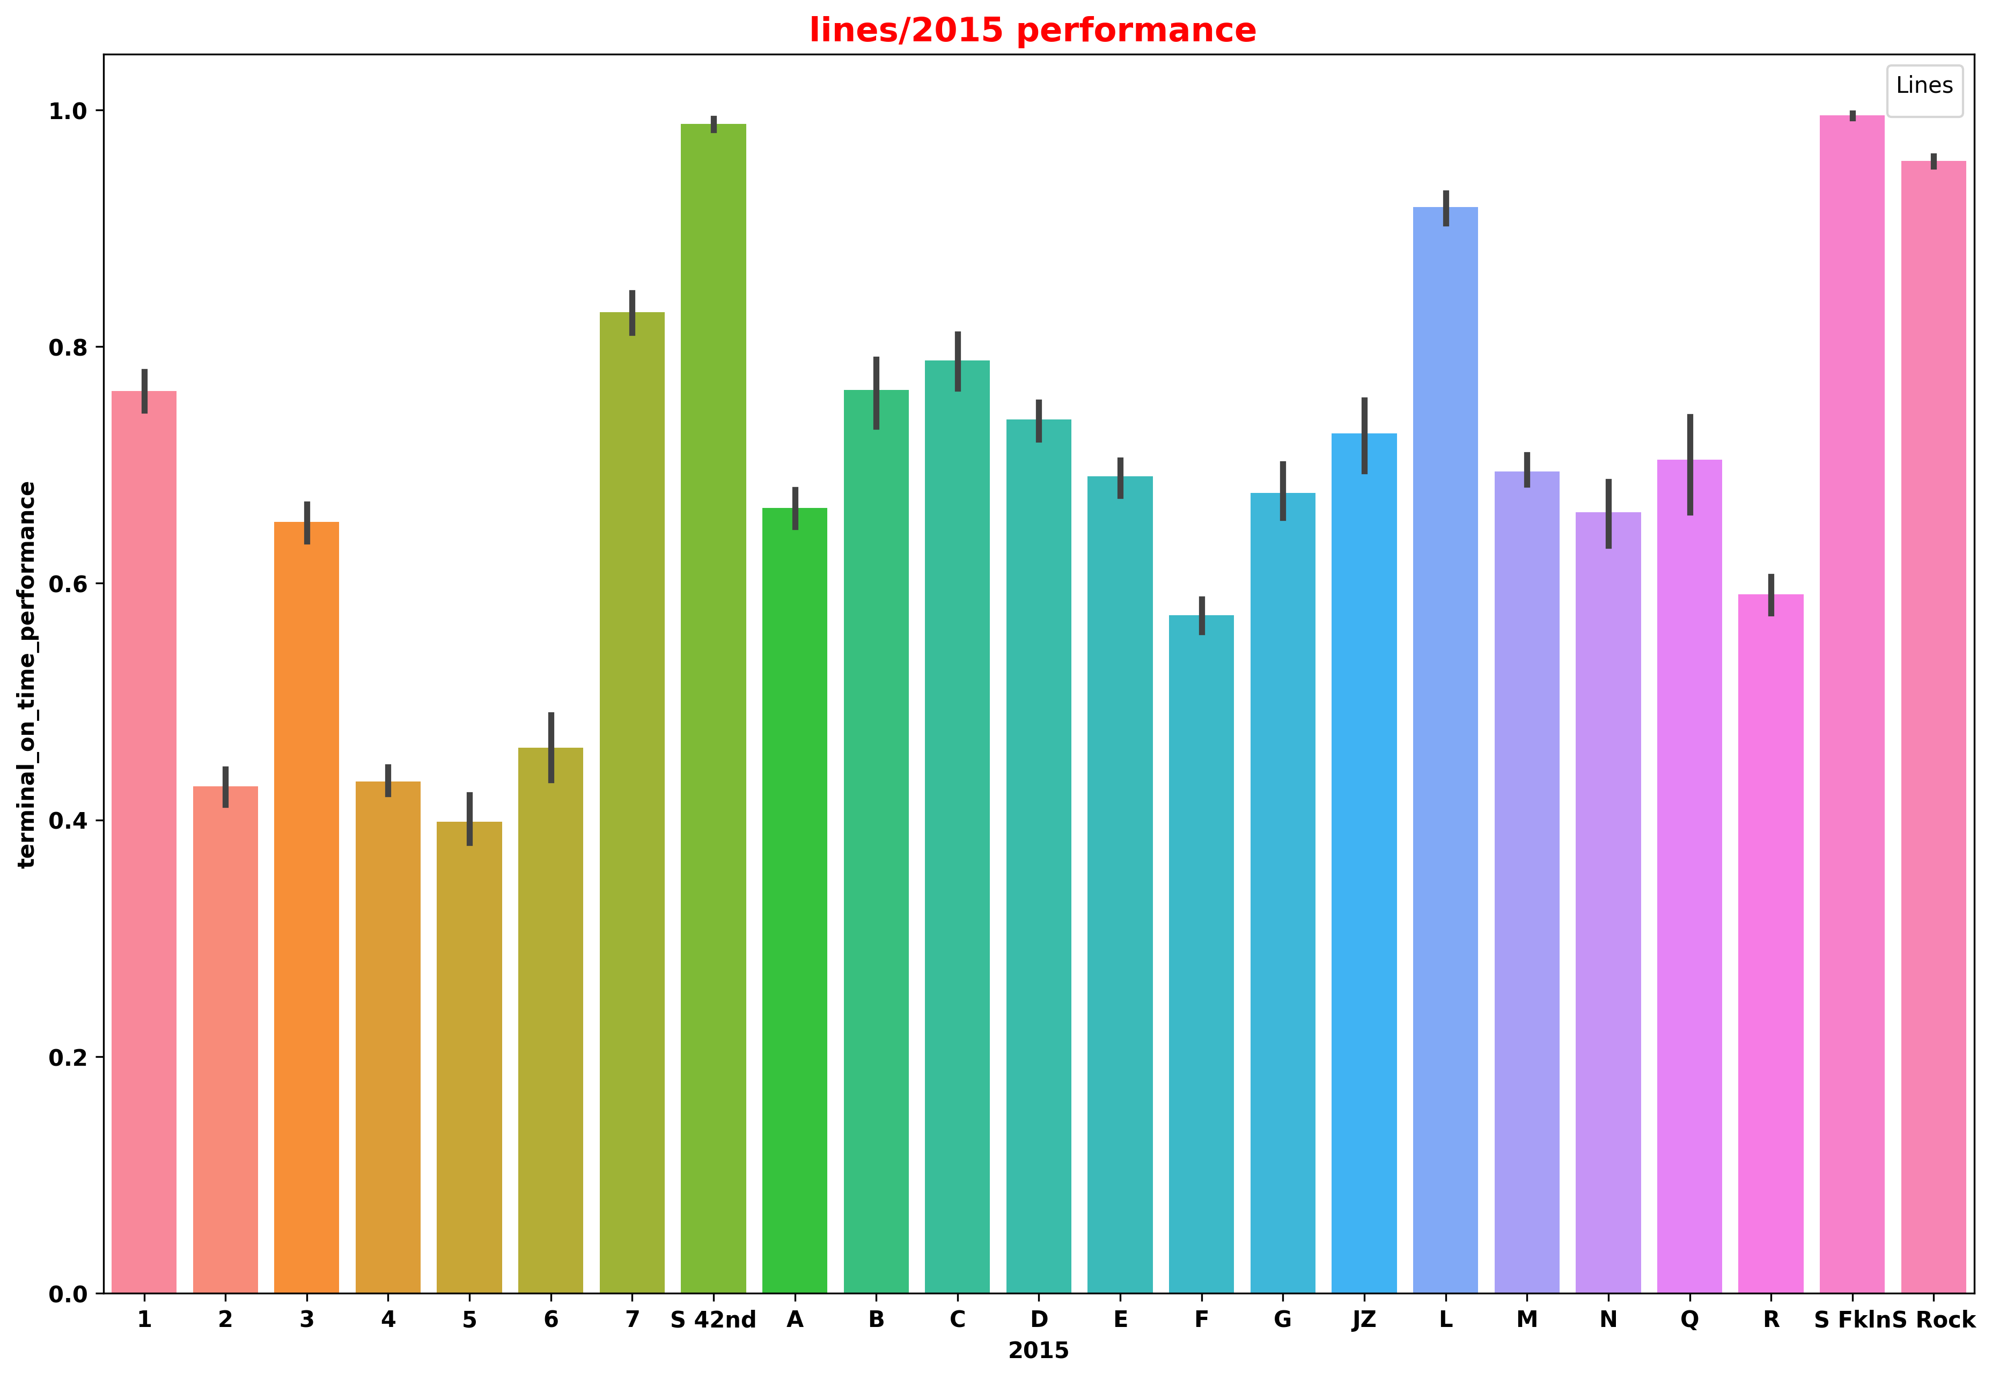
Bar plot for Lines Performance in 2015
This slide shows a bar plot of the performance of different subway lines over the years. The x-axis represents the year, and the y-axis represents the terminal_on_time_performance. The hue represents different subway lines. Another bar plot shows the performance of subway lines in 2015.

Slide 33
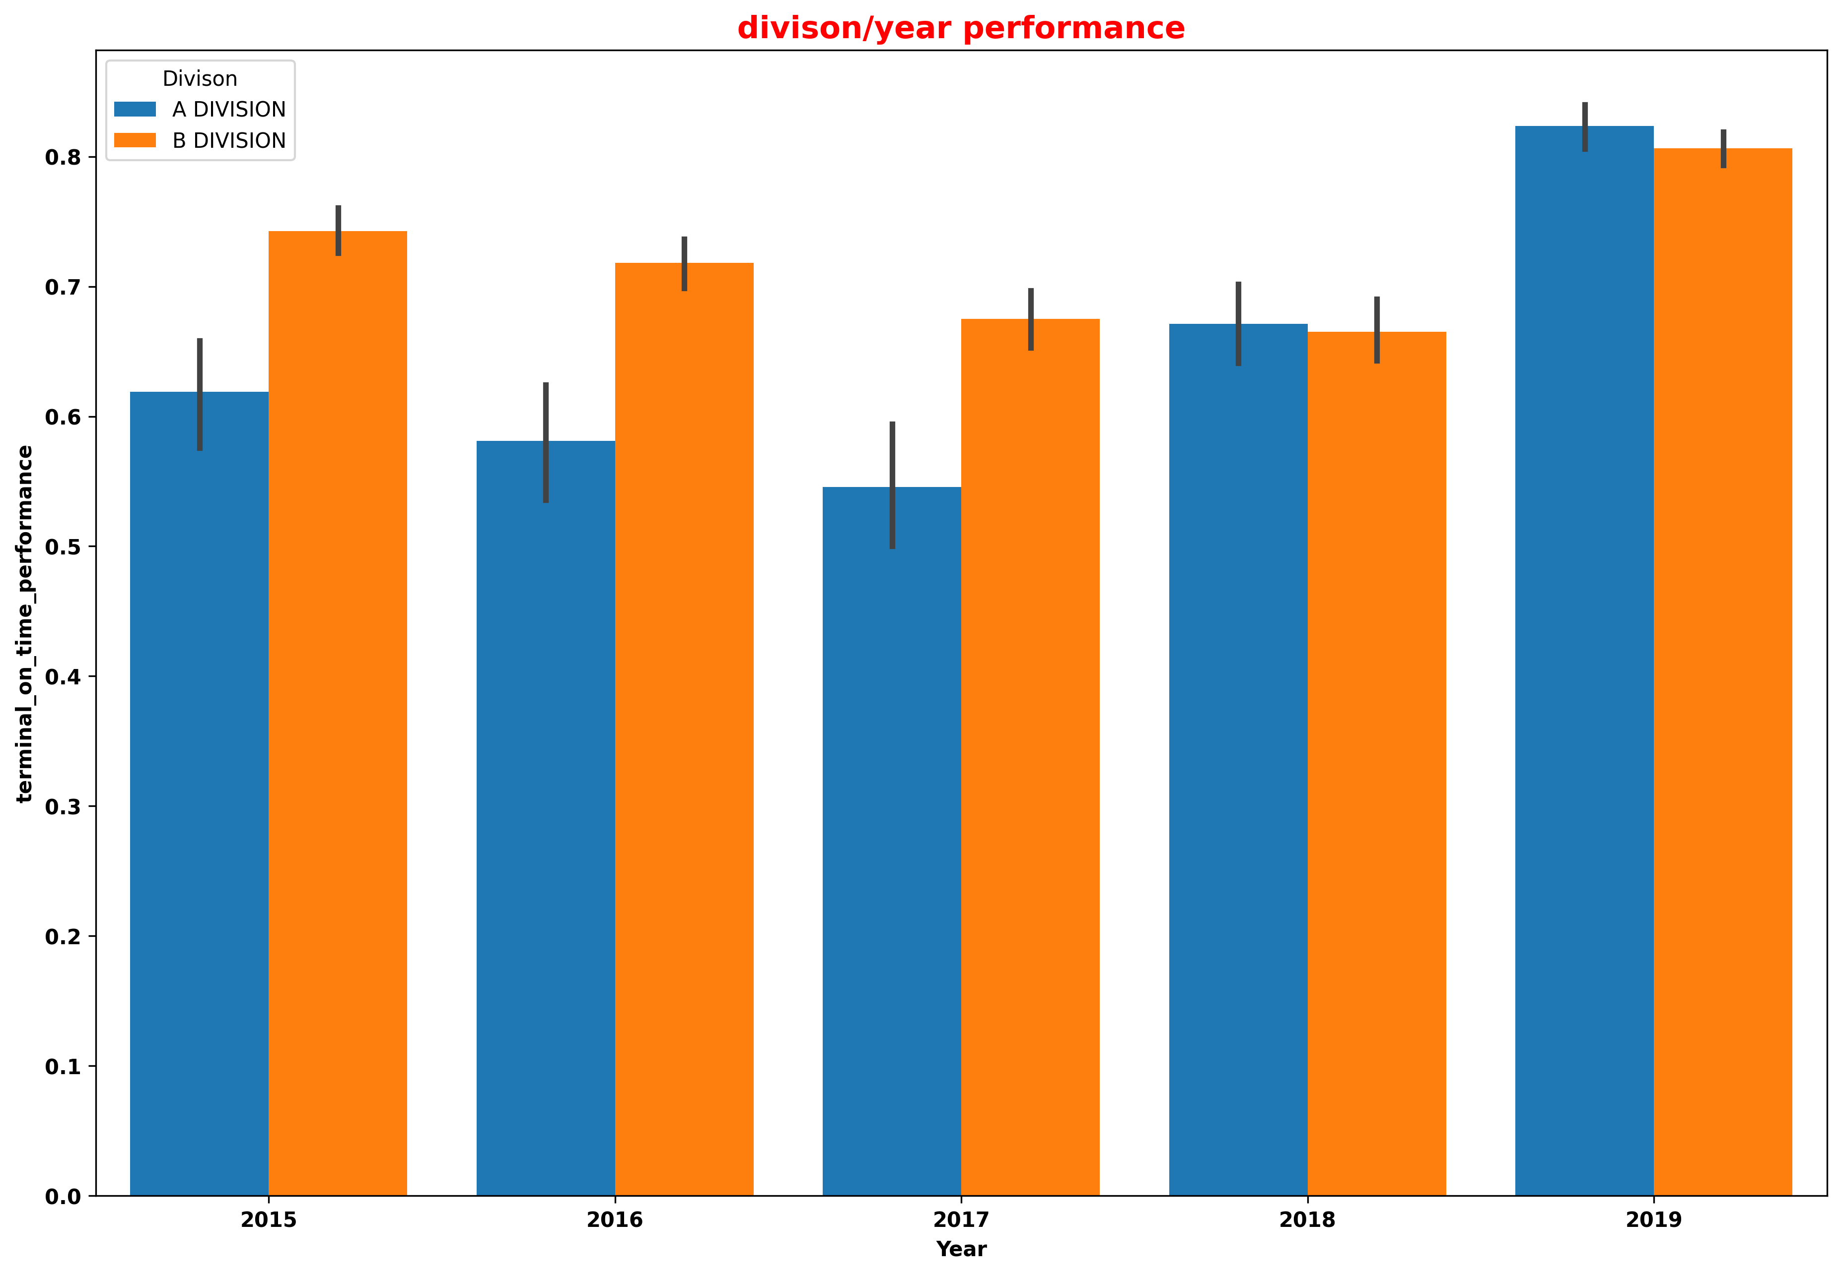
Barplot for Division/Year Performance
This bar plot displays the performance of different divisions of a transit system over time. Each bar represents a year, and is colored by division. The height of each bar corresponds to the average terminal on-time performance for that year. The legend shows the corresponding division for each color. The plot allows us to compare the performance of different divisions over time,and identify any trends or patterns. The title of the plot is "Division/Year Performance".

Slide 34
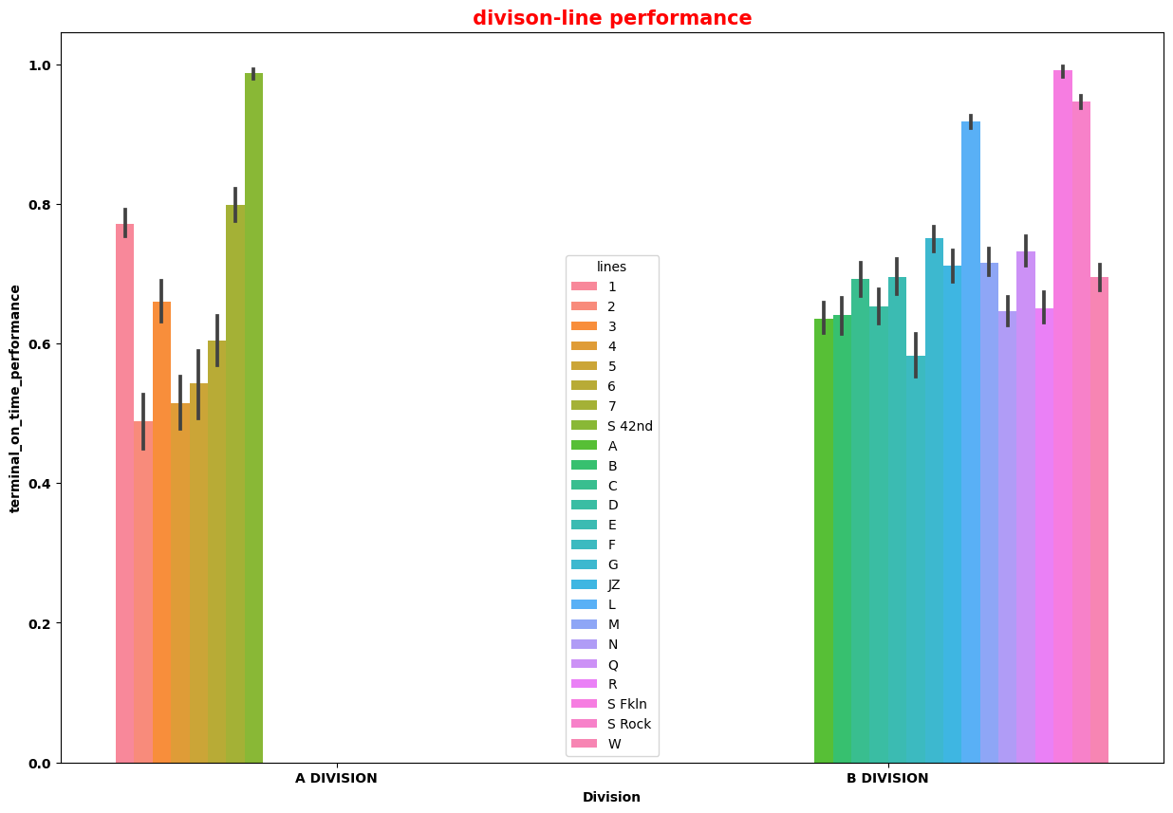
Bar plot for Division-Line Performance
This data presentation shows the on-time performance of different lines across various divisions in a bar plot format. The x-axis represents the divisions while the y-axis represents the terminal on-time performance. The hue parameter shows the different lines under each division. The legend shows the different lines represented by different colors.

Slide 35
PREDICTIVE ANALYSIS
The term predictive analytics refers to the use of statistics and modeling techniques to make predictions about future outcomes and performance. Predictive analytics looks at current and historical data patterns to determine if those patterns are likely to emerge again.
In the current dataset that we have

Slide 36
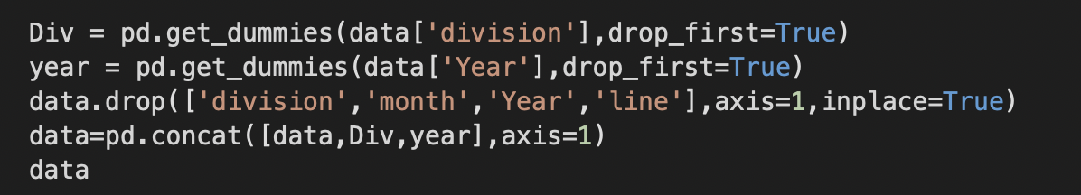
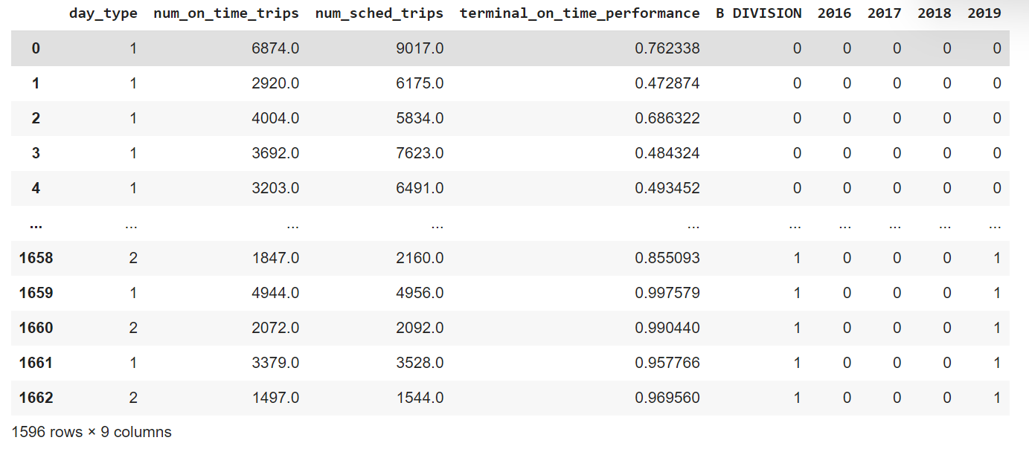
Data preprocessing for regression analysis
Adding “Div” and “year” columns to the data and filling them with dummy values.
Displaying the output of preprocessed data.

Slide 37
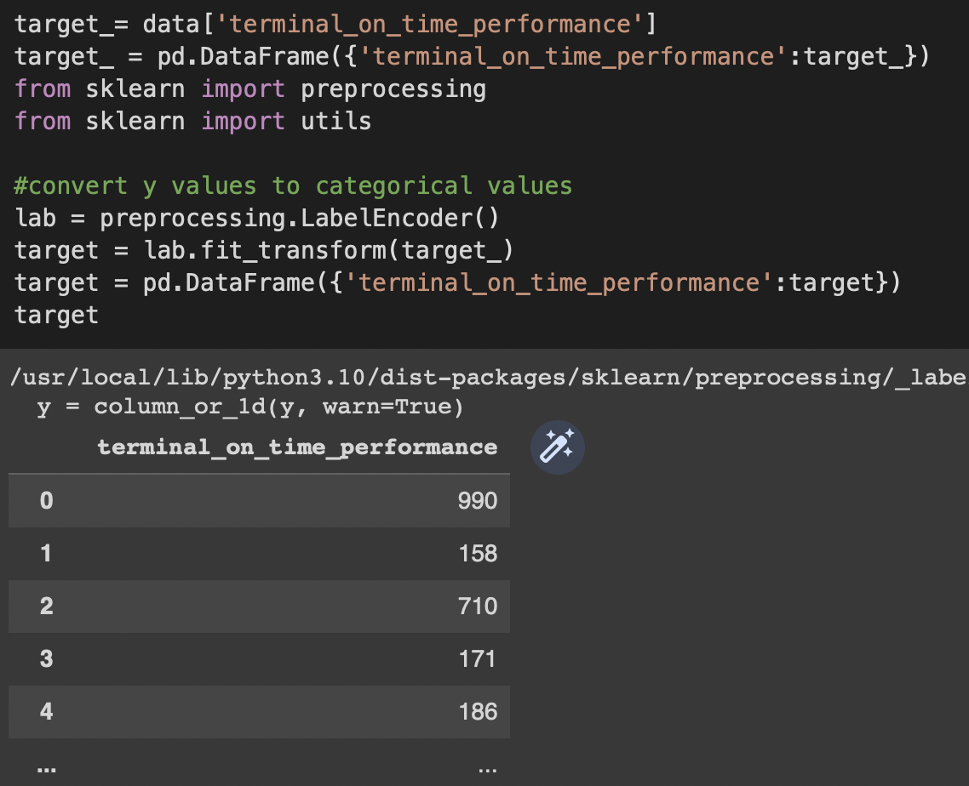
Target variable preprocessing using Label Encoder
Convert y values to categorical values: The code is using the Label Encoder function to convert the target variable from continuous numerical values to categorical values, which is often necessary for certain machine learning models to work properly.
Checking for label encoding success: The code creates a new Data Frame called 'target' to store the encoded target variable and uses the utils module from scikit-learn to check that the encoding was successful. This step is important to ensure that the target variable is properly encoded before using it in any machine learning model.

Slide 38
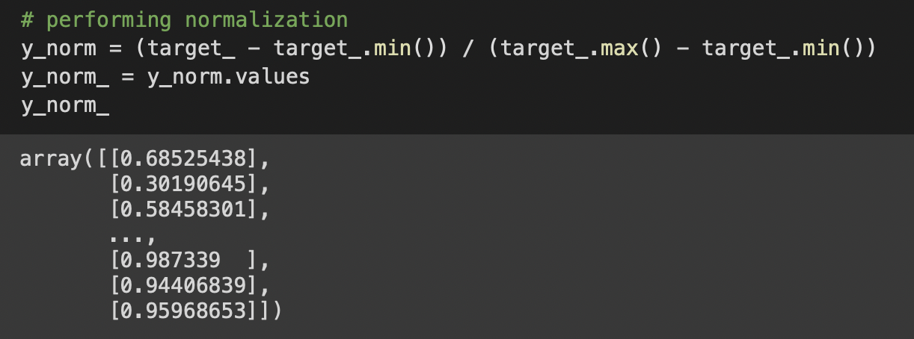
Normalization of target variable
Formula for normalization: The code uses the formula for min-max normalization to scale the values of the target variable between 0 and 1. This is done to ensure that all variables are on the same scale, which can be important for certain machine learning models to work properly.
Checking normalization success: The code creates a new variable called 'y_norm_' to store the normalized values of the target variable and uses the .values method to convert it to a NumPy array. This step is important to ensure that the normalization was successful and that the values of the target variable are now between 0 and 1.

Slide 39
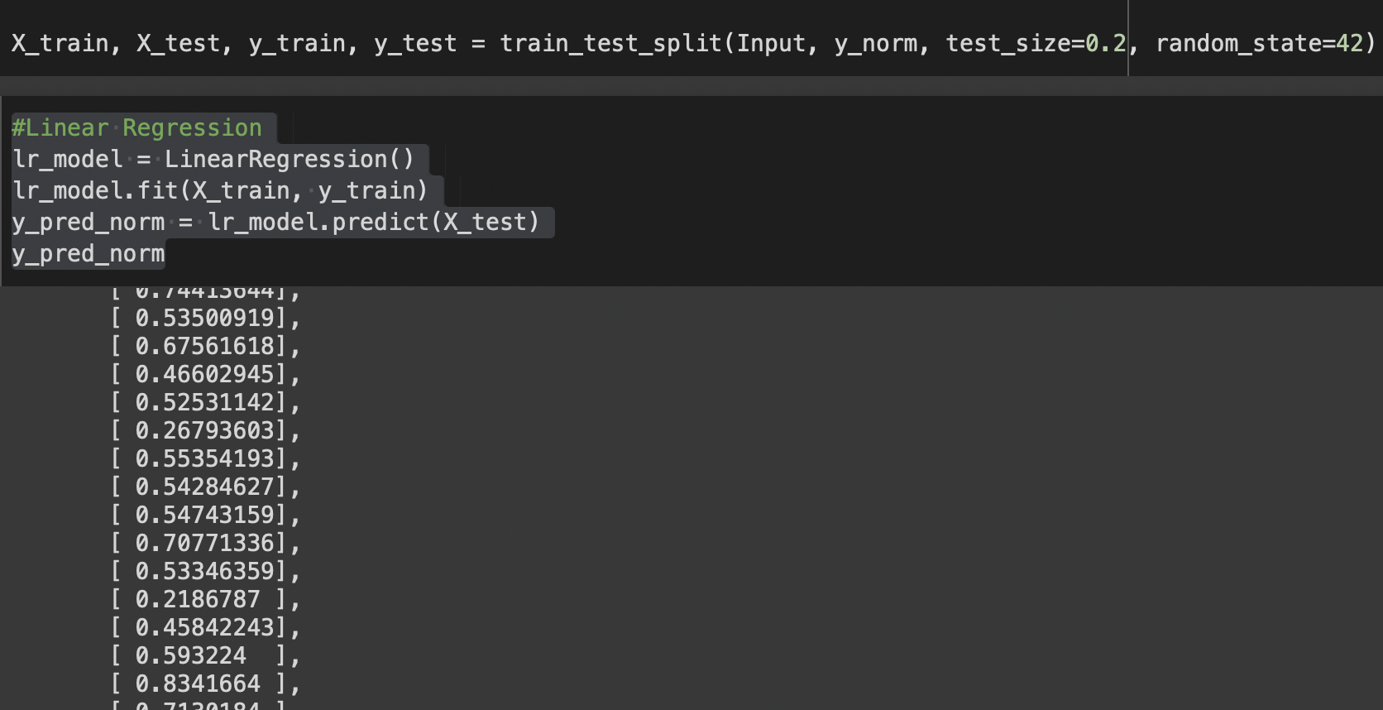
Train-test split and linear regression

Slide 40
Train-test split and linear regression
Train-test split: The code uses the train_test_split function from the scikit-learn library to randomly split the dataset into training and testing sets. The training set is used to train the linear regression model, and the testing set is used to evaluate the model's performance.
Model training and prediction: The code uses the fit method of the linear regression model object to train the model on the training data, and the predict method of the model to generate predicted values of the target variable for the test data, which are stored in the variable 'y_pred_norm'. This step is important to evaluate the model's performance on previously unseen data, which is a better measure of how well the model will generalize to new data.

Slide 41
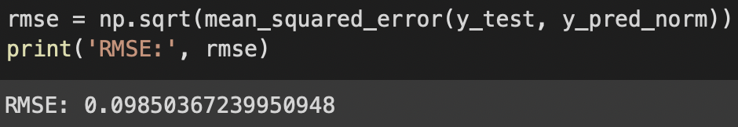
Calculation of root mean squared error (RMSE)
Formula for RMSE: The code uses the mean_squared_error function from the scikit-learn library to calculate the mean squared error (MSE) between the predicted values of the target variable and the actual values for the testing data. The MSE is then square-rooted to get the RMSE.
Interpretation of RMSE: The code prints the value of the RMSE to the console, which is a measure of the average distance between the predicted and actual values of the target variable. A lower RMSE indicates that the model is better at predicting the target variable, while a higher RMSE indicates that the model's predictions are less accurate. The RMSE value can be used to compare the performance of different machine learning models on the same dataset.

Slide 42
THANK YOU!

